Slide 1
Applications (1 of 2): Information Retrieval
Kenneth Church
Kenneth.Church@jhu.edu

Slide 2
Pattern Recognition Problems in Computational Linguistics
Information Retrieval:
Is this doc more like relevant docs or irrelevant docs?
Author Identification:
Is this doc more like author A’s docs or author B’s docs?
Word Sense Disambiguation
Is the context of this use of bank
more like sense 1’s contexts
or like sense 2’s contexts?
Machine Translation
Is the context of this use of drug more like those that were translated as drogue
or those that were translated as medicament?

Slide 3
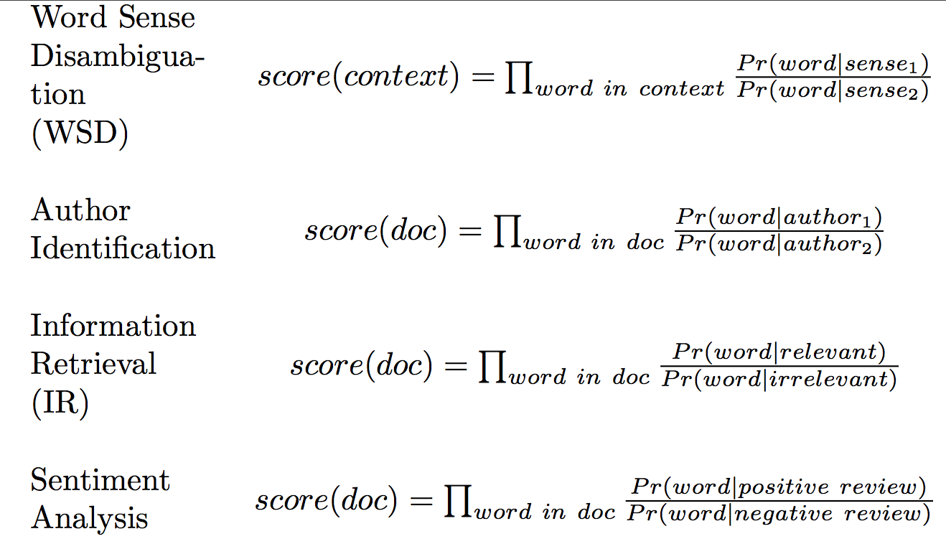
Applications of Naïve Bayes

Slide 4
Classical Information Retrieval (IR)
Boolean Combinations of Keywords
Dominated the Market (before the web)
Popular with Intermediaries (Librarians)
Rank Retrieval (Google)
Sort a collection of documents
(e.g., scientific papers, abstracts, paragraphs)
by how much they ‘‘match’’ a query
The query can be a (short) sequence of keywords
or arbitrary text (e.g., one of the documents)

Slide 5
Motivation for Information Retrieval (circa 1990, about 5 years before web)
Text is available like never before
Currently, N≈100 million words
and projections run as high as 10¹⁵ bytes by 2000!
What can we do with it all?
It is better to do something simple,
than nothing at all.
IR vs. Natural Language Understanding
Revival of 1950-style empiricism

Slide 6
How Large is Very Large? From a Keynote to EMNLP Conference, formally Workshop on Very Large Corpora

Slide 7
Rising Tide of Data Lifts All Boats If you have a lot of data, then you don’t need a lot of methodology
1985: “There is no data like more data”
Fighting words uttered by radical fringe elements (Mercer at Arden House)
1993 Workshop on Very Large Corpora
Perfect timing: Just before the web
Couldn’t help but succeed
Fate
1995: The Web changes everything
All you need is data (magic sauce)
No linguistics
No artificial intelligence (representation)
No machine learning
No statistics
No error analysis

Slide 8
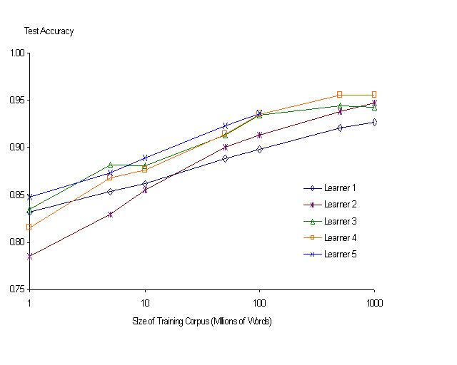
“It never pays to think until you’ve run out of data” – Eric Brill
Moore’s Law Constant:
Data Collection Rates → Improvement Rates
Banko & Brill: Mitigating the Paucity-of-Data Problem (HLT 2001)
No consistently
best learner
More data is better data!
Quoted out of context
Fire everybody and
spend the money on data

Slide 9
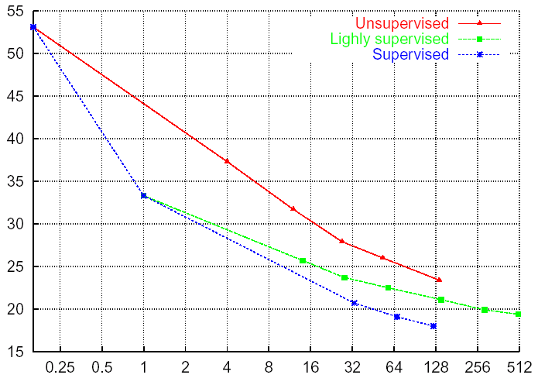
Benefit of Data
Borrowed Slide: Jelinek (LREC)
LIMSI: Lamel (2002) – Broadcast News
WER
hours
Supervised: transcripts
Lightly supervised: closed captions

Slide 10
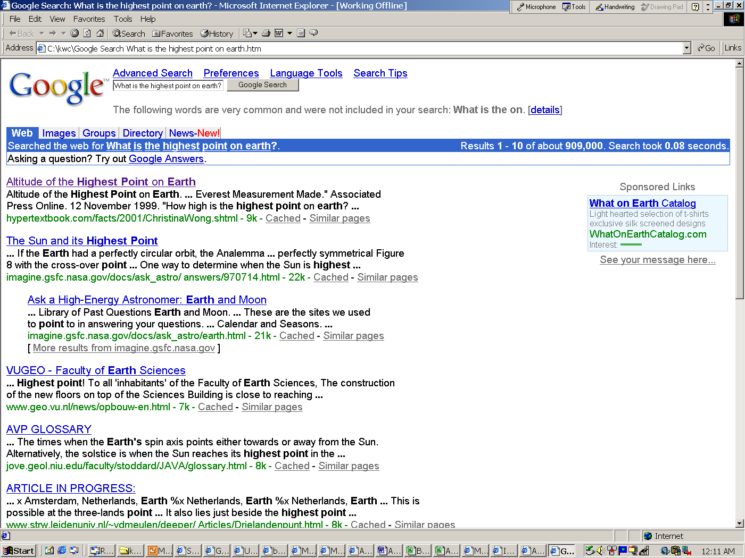
The rising tide of data will lift all boats! TREC Question Answering & Google: What is the highest point on Earth?

Slide 11
The rising tide of data will lift all boats! Acquiring Lexical Resources from Data: Dictionaries, Ontologies, WordNets, Language Models, etc. http://labs1.google.com/sets
England | Japan | Cat | cat
France | China | Dog | more
Germany | India | Horse | ls
Italy | Indonesia | Fish | rm
Ireland | Malaysia | Bird | mv
Spain | Korea | Rabbit | cd
Scotland | Taiwan | Cattle | cp
Belgium | Thailand | Rat | mkdir
Canada | Singapore | Livestock | man
Austria | Australia | Mouse | tail
Australia | Bangladesh | Human | pwd

Slide 12
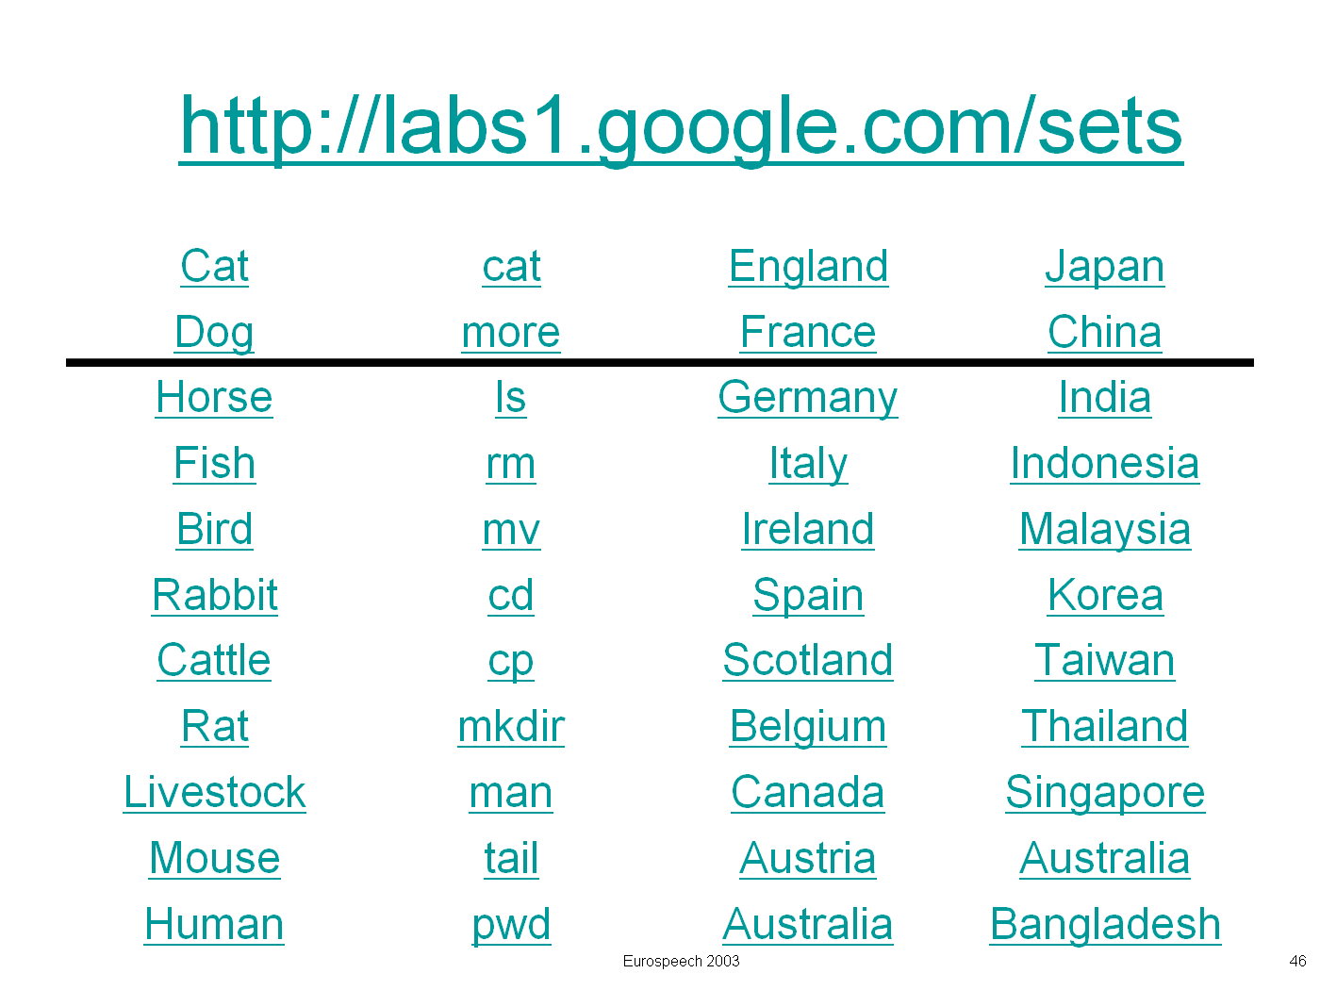
Rising Tide of Data Lifts All Boats If you have a lot of data, then you don’t need a lot of methodology
More data → better results
TREC Question Answering
Remarkable performance: Google and not much else
Norvig (ACL-02)
AskMSR (SIGIR-02)
Lexical Acquisition
Google Sets
We tried similar things
but with tiny corpora
which we called large

Slide 13
Applications
Don’t worry;
Be happy
What good is word sense disambiguation (WSD)?
Information Retrieval (IR)
Salton: Tried hard to find ways to use NLP to help IR
but failed to find much (if anything)
Croft: WSD doesn’t help because IR is already using those methods
Sanderson (next two slides)
Machine Translation (MT)
Original motivation for much of the work on WSD
But IR arguments may apply just as well to MT
What good is POS tagging? Parsing? NLP? Speech?
Commercial Applications of Natural Language Processing, CACM 1995
$100M opportunity (worthy of government/industry’s attention)
Search (Lexis-Nexis)
Word Processing (Microsoft)
Warning: premature commercialization is risky
5 Ian Andersons
ALPAC

Slide 14
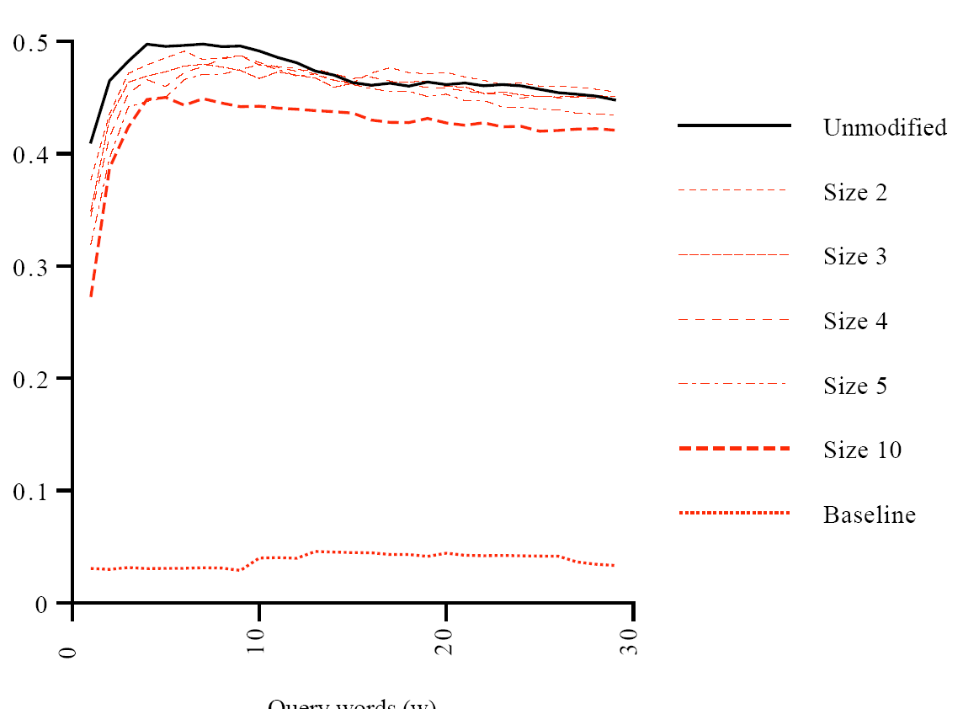
Sanderson (SIGIR-94) http://dis.shef.ac.uk/mark/cv/publications/papers/my_papers/SIGIR94.pdf
Not much?
Could WSD help IR?
Answer: no
Introducing ambiguity by pseudo-words doesn’t hurt (much)
F
5 Ian Andersons
Query Length (Words)
Short queries matter most, but hardest for WSD

Slide 15
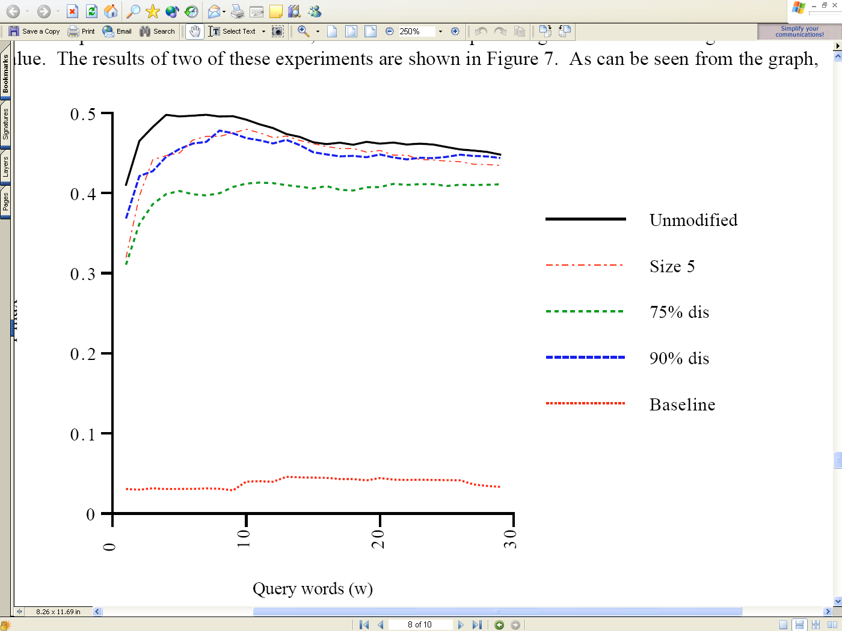
Sanderson (SIGIR-94) http://dis.shef.ac.uk/mark/cv/publications/papers/my_papers/SIGIR94.pdf
Soft WSD?
F
Resolving ambiguity badly is worse than not resolving at all
75% accurate WSD degrades performance
90% accurate WSD: breakeven point
Query Length (Words)

Slide 16
IR Models
Keywords (and Boolean combinations thereof)
Vector-Space ‘‘Model’’ (Salton, chap 10.1)
Represent the query and the documents as V- dimensional vectors
Sort vectors by
Probabilistic Retrieval Model
(Salton, chap 10.3)
Sort documents by

Slide 17
Information Retrieval and Web Search
Alternative IR models
Instructor: Rada Mihalcea
Some of the slides were adopted from a course tought at Cornell University by William Y. Arms

Slide 18
Latent Semantic Indexing
Objective
Replace indexes that use sets of index terms by indexes that use concepts.
Approach
Map the term vector space into a lower dimensional space, using singular value decomposition.
Each dimension in the new space corresponds to a latent concept in the original data.

Slide 19
Deficiencies with Conventional Automatic Indexing
Synonymy: Various words and phrases refer to the same concept (lowers recall).
Polysemy: Individual words have more than one meaning (lowers precision)
Independence: No significance is given to two terms that frequently appear together
Latent semantic indexing addresses the first of these (synonymy),
and the third (dependence)

Slide 20
Bellcore’s Example http://en.wikipedia.org/wiki/Latent_semantic_analysis
c1 Human machine interface for Lab ABC computer applications
c2 A survey of user opinion of computer system response time
c3 The EPS user interface management system
c4 System and human system engineering testing of EPS
c5 Relation of user-perceived response time to error measurement
m1 The generation of random, binary, unordered trees
m2 The intersection graph of paths in trees
m3 Graph minors IV: Widths of trees and well-quasi-ordering
m4 Graph minors: A survey

Slide 21
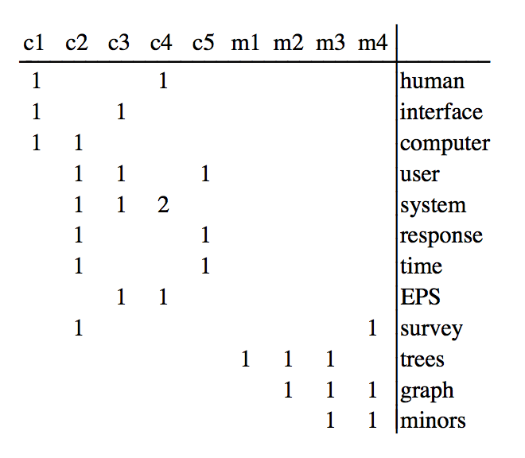
Term by Document Matrix

Slide 22
Query Expansion
Query:
Find documents relevant to human computer interaction
Simple Term Matching:
Matches c1, c2, and c4
Misses c3 and c5

Slide 23
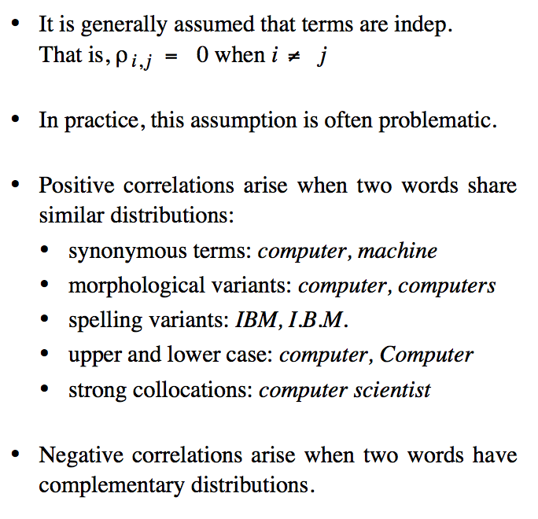
Large Correl-ations

Slide 24
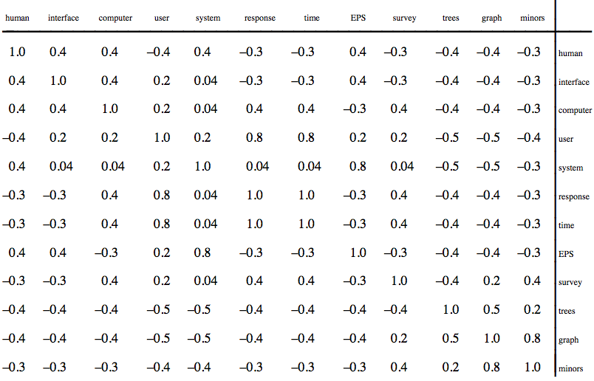
Correlations: Too Large to Ignore

Slide 25
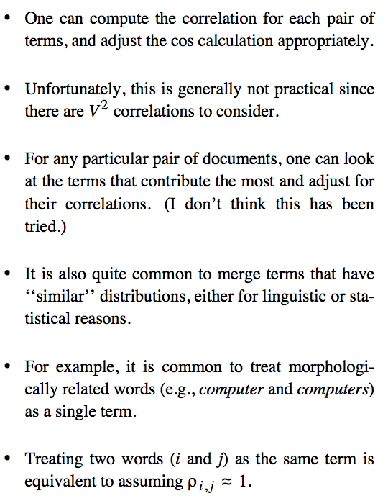
Correcting for Large Correlations

Slide 26
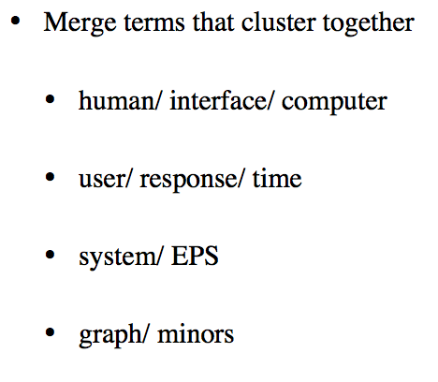
Thesaurus

Slide 27
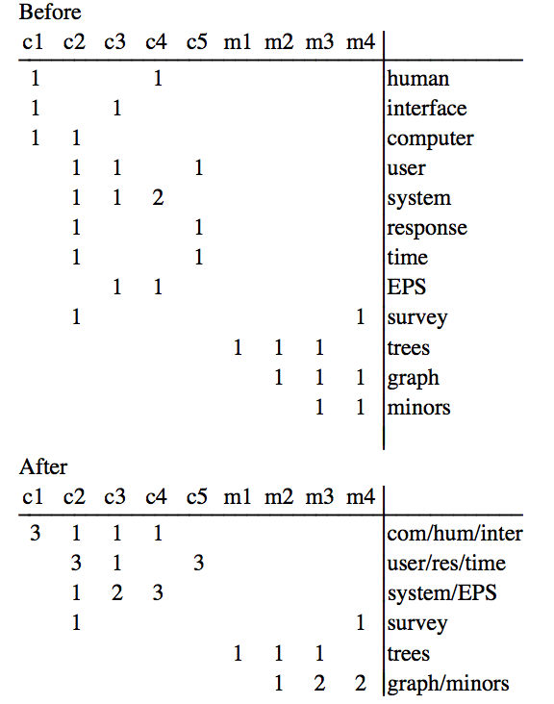
Term by Doc Matrix: Before & After Thesaurus

Slide 28
Singular Value Decomposition (SVD) X = UDV^{T}
t x d
t x m
m x m
m x d
D
V^{T}
X
=
U
m is the rank of X < min(t, d)
D is diagonal
D² are eigenvalues (sorted in descending order)
U U^{T} = I and V V^{T} = I
Columns of U are eigenvectors of X X^{T}
Columns of V are eigenvectors of X^{T} X

Slide 29
Dimensionality Reduction
t x d
t x k
k x k
k x d
D
V^{T}
^
=
X
U
k is the number of latent concepts
(typically 300 ~ 500)

Slide 30
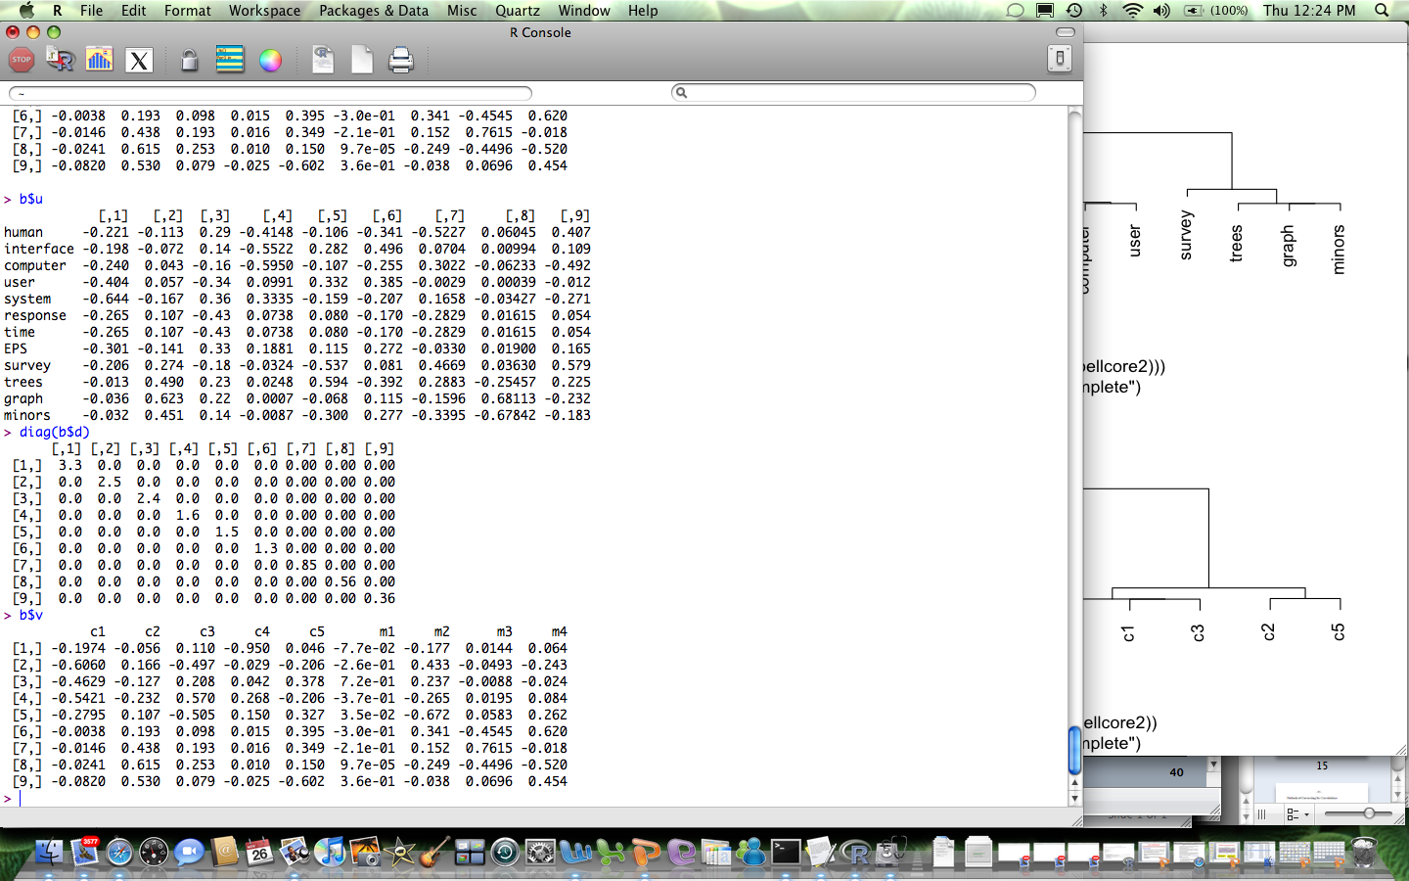
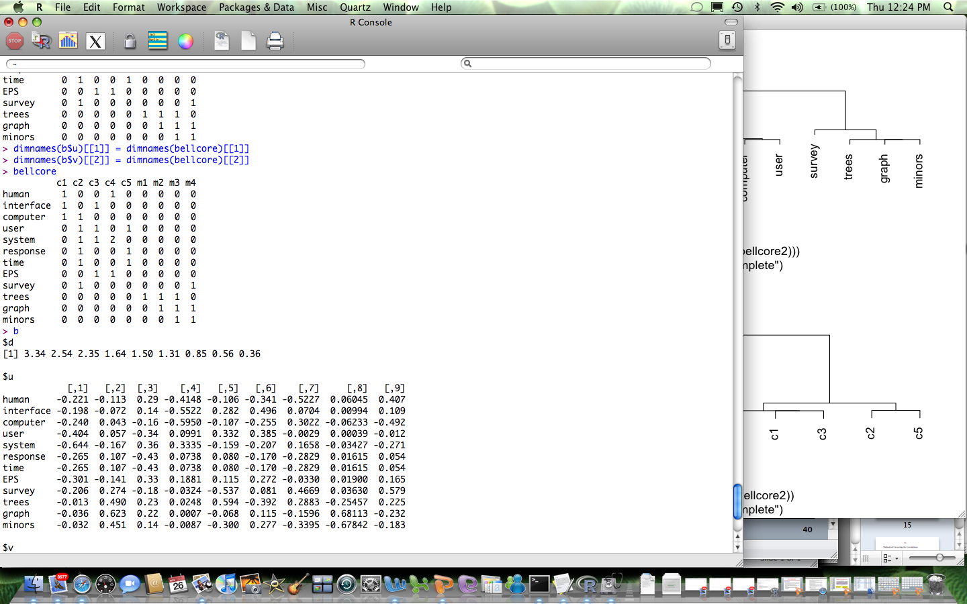
SVD B B^{T} = U D² U^{T} B^{T} B = V D² V^{T}
Doc
Term
Latent

Slide 31
The term vector space
t₃
The space has as many dimensions as there are terms in the word list.
d₁
d₂
θ
t₂
t₁

Slide 32
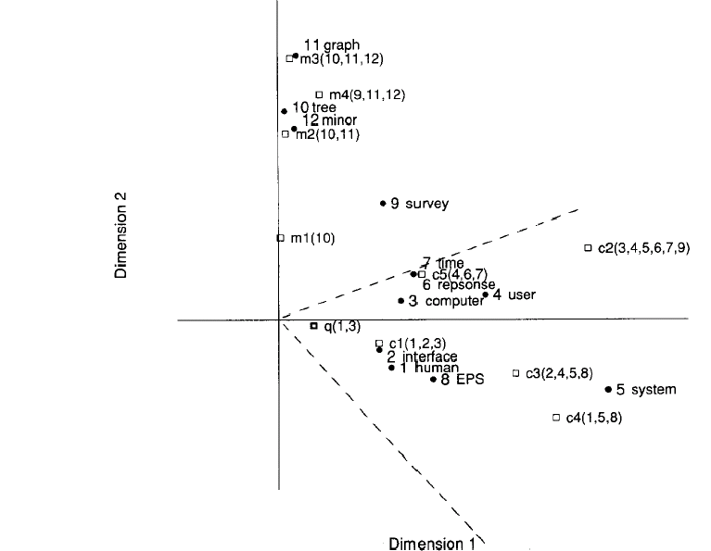
Latent concept vector space
• term
document
query
--- cosine > 0.9

Slide 33
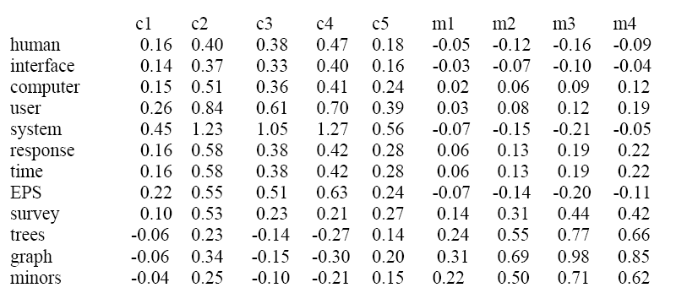
Recombination after Dimensionality Reduction

Slide 34
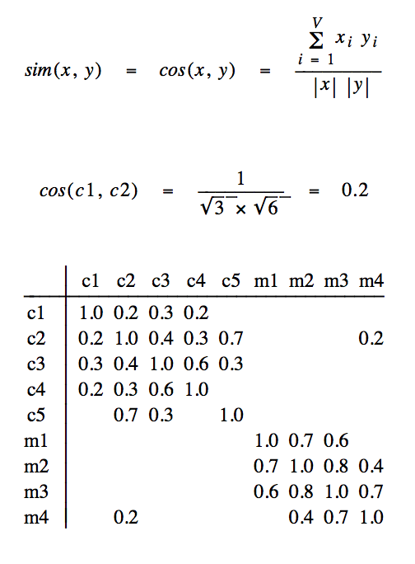
Document Cosines (before dimensionality reduction)

Slide 35
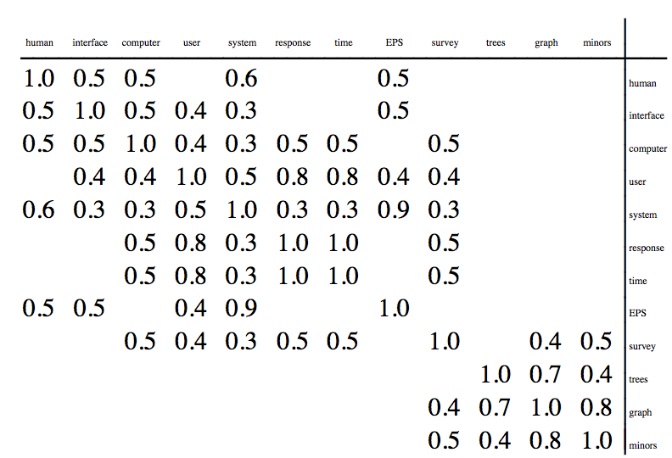
Term Cosines (before dimensionality reduction)

Slide 36
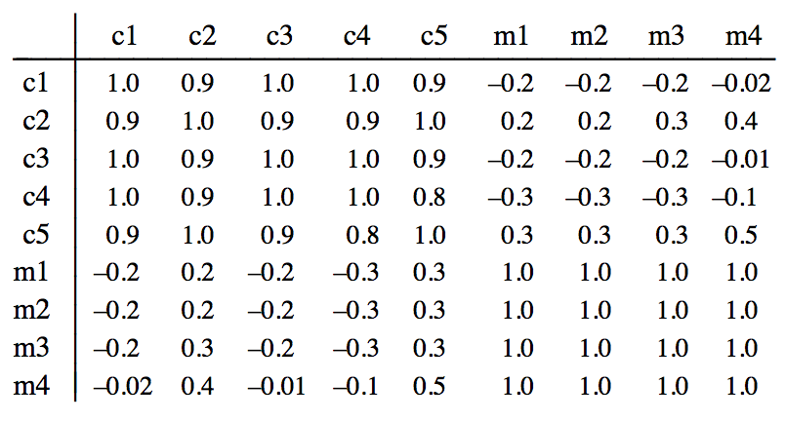
Document Cosines (after dimensionality reduction)

Slide 37
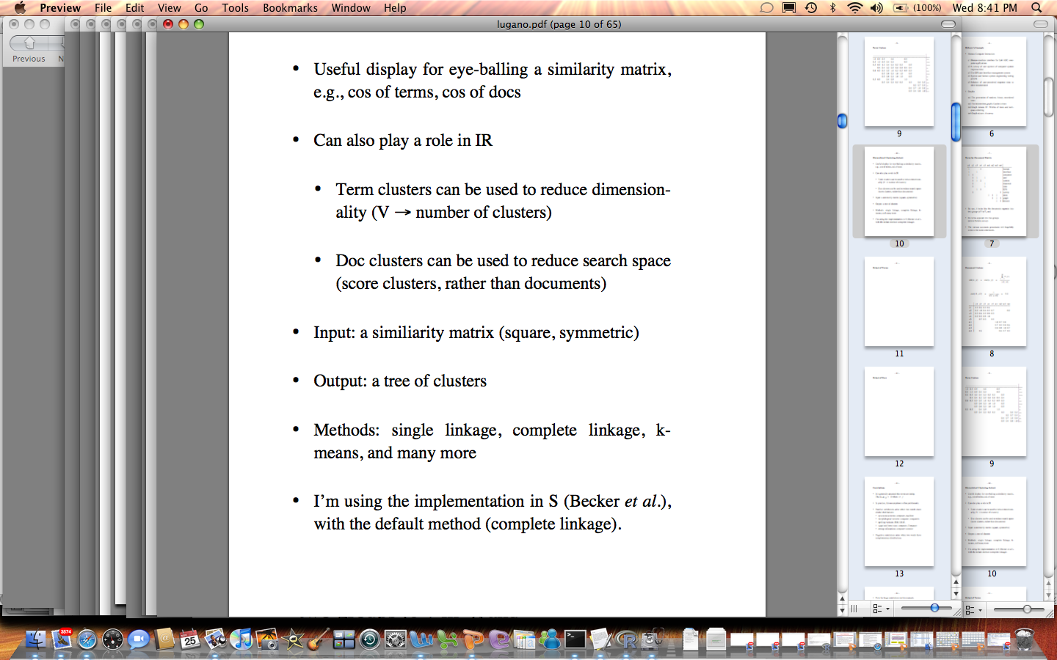
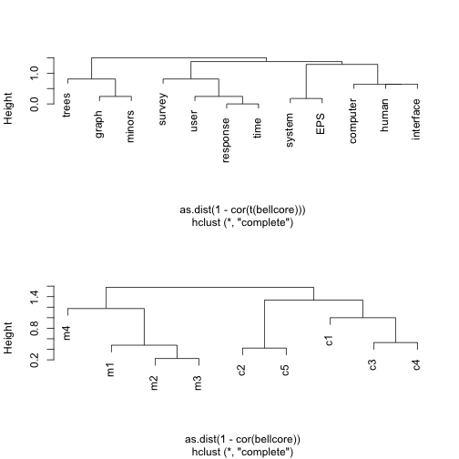
Clustering

Slide 38
Clustering (before dimensionality reduction)

Slide 39
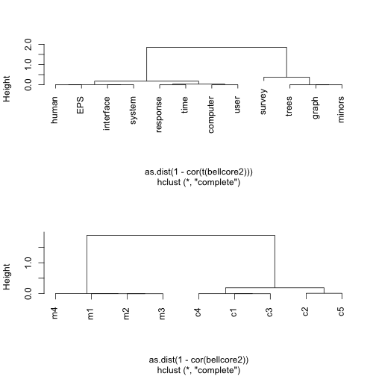
Clustering (after dimensionality reduction)

Slide 40
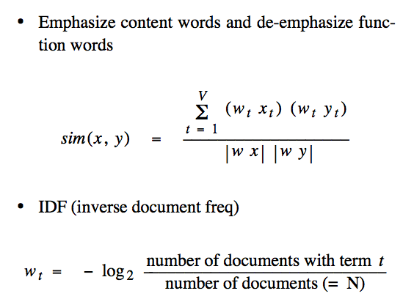
Stop Lists & Term Weighting

Slide 41
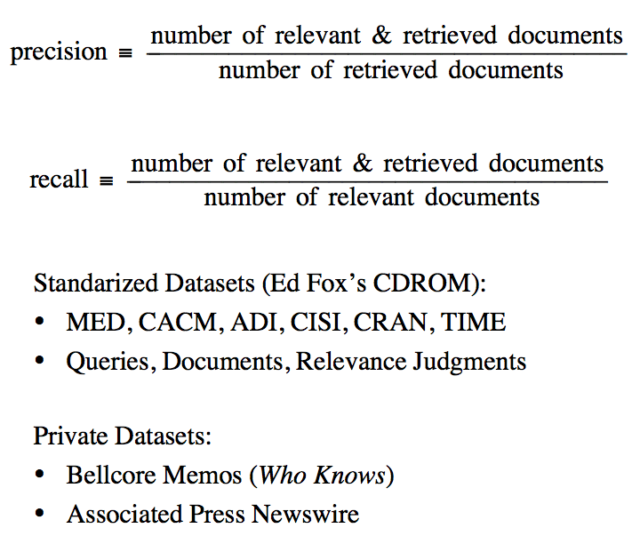
Evaluation

Slide 42
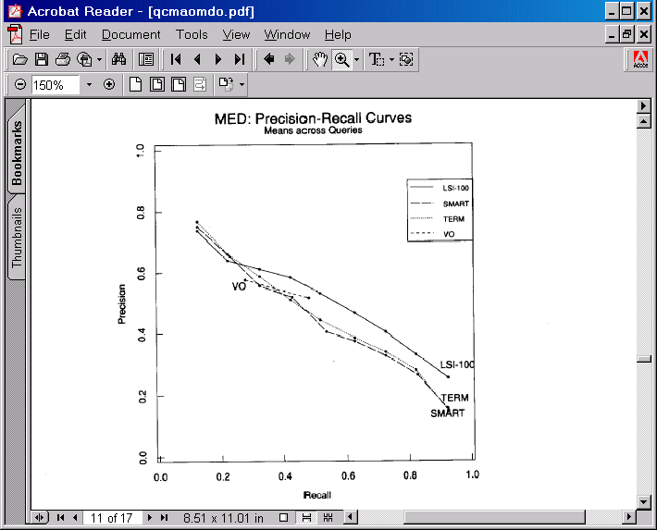
Experimental Results: 100 Factors

Slide 43
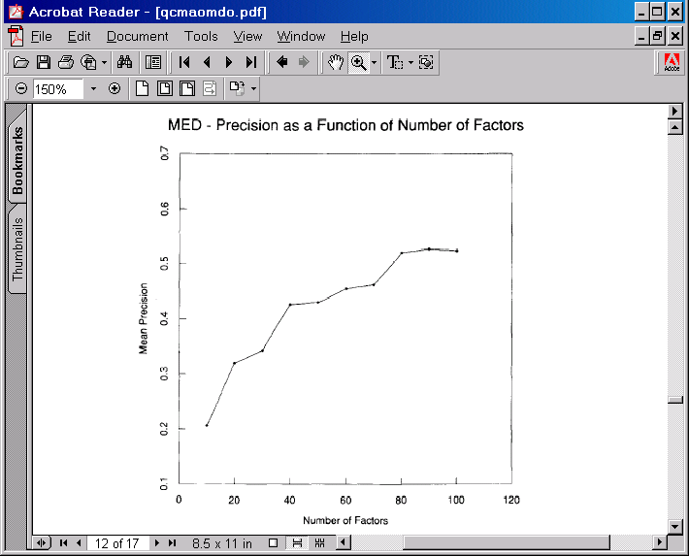
Experimental Results: Number of Factors

Slide 44
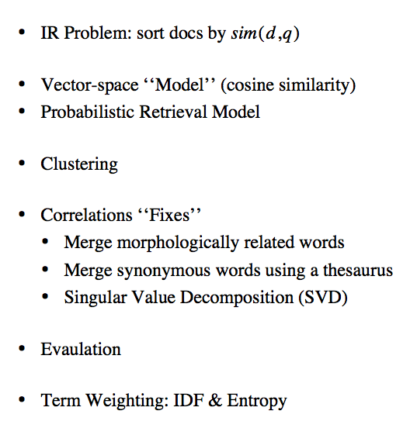
Summary

Slide 45
Entropy of Search Logs - How Big is the Web? - How Hard is Search? - With Personalization? With Backoff?
Qiaozhu Mei†, Kenneth Church‡
† University of Illinois at Urbana-Champaign
‡ Microsoft Research

Slide 46
How Big is the Web? 5B? 20B? More? Less?
Small
What if a small cache of millions of pages
Could capture much of the value of billions?
Could a Big bet on a cluster in the clouds
Turn into a big liability?
Examples of Big Bets
Computer Centers & Clusters
Capital (Hardware)
Expense (Power)
Dev (Mapreduce, GFS, Big Table, etc.)
Sales & Marketing >> Production & Distribution

Slide 47
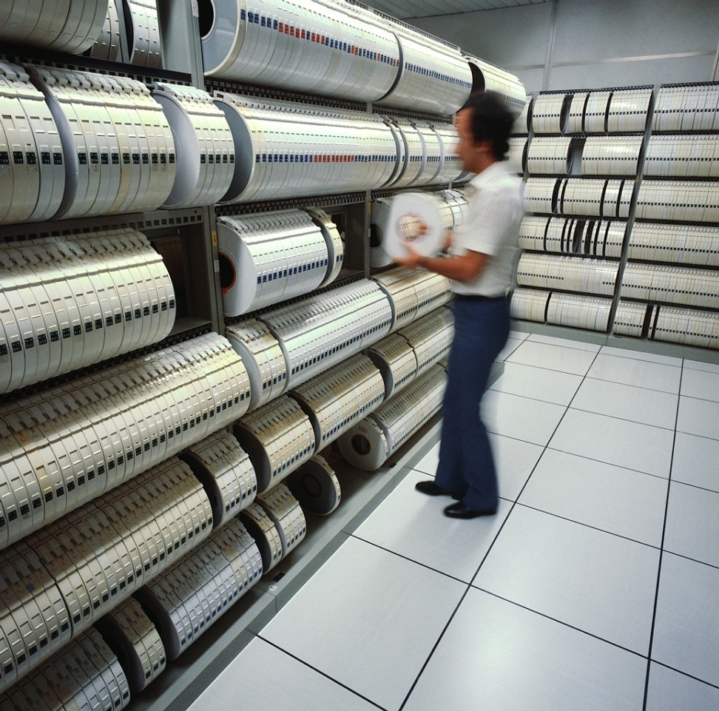
Millions (Not Billions)

Slide 48
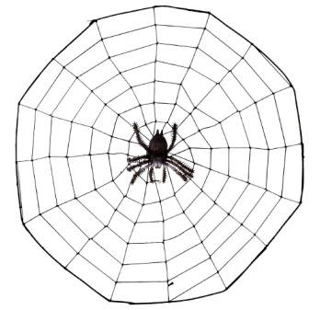
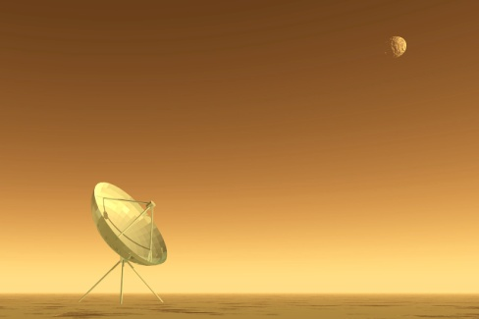

Population Bound
With all the talk about the Long Tail
You’d think that the Web was astronomical
Carl Sagan: Billions and Billions…
Lower Distribution $$ → Sell Less of More
But there are limits to this process
NetFlix: 55k movies (not even millions)
Amazon: 8M products
Vanity Searches: Infinite???
Personal Home Pages << Phone Book < Population
Business Home Pages << Yellow Pages < Population
Millions, not Billions (until market saturates)

Slide 49
It Will Take Decades to Reach Population Bound
Most people (and products)
don’t have a web page (yet)
Currently, I can find famous people
(and academics)
but not my neighbors
There aren’t that many famous people
(and academics)…
Millions, not billions
(for the foreseeable future)

Slide 50
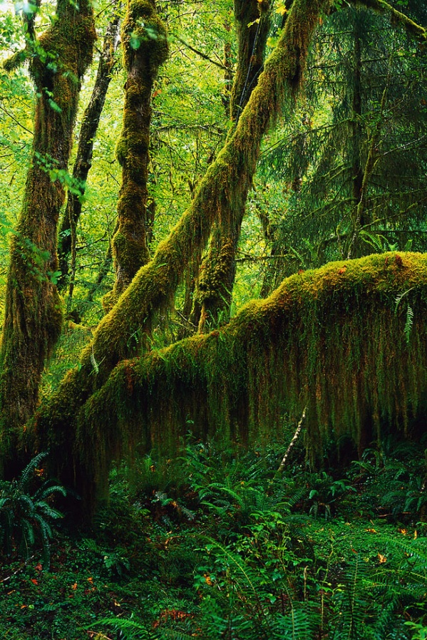
Equilibrium: Supply = Demand
If there is a page on the web,
And no one sees it,
Did it make a sound?
How big is the web?
Should we count “silent” pages
That don’t make a sound?
How many products are there?
Do we count “silent” flops
That no one buys?

Slide 51
Demand Side Accounting
Consumers have limited time
Telephone Usage: 1 hour per line per day
TV: 4 hours per day
Web: ??? hours per day
Suppliers will post as many pages as consumers can consume (and no more)
Size of Web: O(Consumers)

Slide 52
How Big is the Web?
Related questions come up in language
How big is English?
Dictionary Marketing
Education (Testing of Vocabulary Size)
Psychology
Statistics
Linguistics
Two Very Different Answers
Chomsky: language is infinite
Shannon: 1.25 bits per character
How many words do people know?
What is a word? Person? Know?
Notes:
There are two very different answers from the computational perspective:

Slide 53
Chomskian Argument: Web is Infinite
One could write a malicious spider trap
http://successor.aspx?x=0 → http://successor.aspx?x=1 → http://successor.aspx?x=2
Not just academic exercise
Web is full of benign examples like
http://calendar.duke.edu/
Infinitely many months
Each month has a link to the next

Slide 54
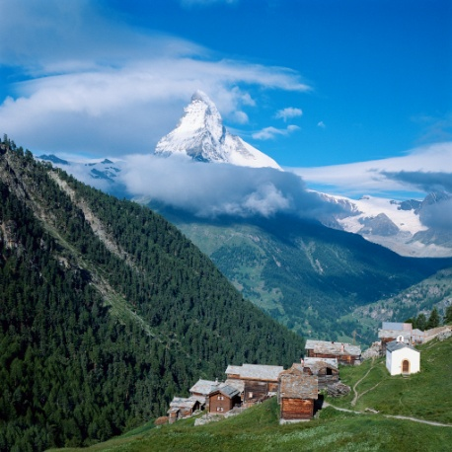
How Big is the Web? 5B? 20B? More? Less?
 | Entropy (H)
Query | 21.1 → 22.9
URL | 22.1 → 22.4
IP | 22.1 → 22.6
All But IP | 23.9
All But URL | 26.0
All But Query | 27.1
All Three | 27.2
MSN Search Log
1 month → x18
More (Chomsky)
http://successor?x=0
Less (Shannon)
More Practical Answer
Comp Ctr ($$$$) → Walk in the Park ($)
Millions
(not Billions)
Cluster in Cloud → Desktop → Flash

Slide 55
Entropy (H)
Size of search space; difficulty of a task
H = 20 → 1 million items distributed uniformly
Powerful tool for sizing challenges and opportunities
How hard is search?
How much does personalization help?

Slide 56
How Hard Is Search? Millions, not Billions
Traditional Search
H(URL | Query)
2.8 (= 23.9 – 21.1)
Personalized Search
H(URL | Query, IP)
1.2 (= 27.2 – 26.0)
 | Entropy (H)
Query | 21.1
URL | 22.1
IP | 22.1
All But IP | 23.9
All But URL | 26.0
All But Query | 27.1
All Three | 27.2
Personalization cuts H in Half!

Slide 57
Difficulty of Queries
Easy queries (low H(URL|Q)):
google, yahoo, myspace, ebay, …
Hard queries (high H(URL|Q)):
dictionary, yellow pages, movies,
“what is may day?”

Slide 58
How Hard are Query Suggestions? The Wild Thing? C* Rice → Condoleezza Rice
Traditional Suggestions
H(Query)
21 bits
Personalized
H(Query | IP)
5 bits (= 26 – 21)
 | Entropy (H)
Query | 21.1
URL | 22.1
IP | 22.1
All But IP | 23.9
All But URL | 26.0
All But Query | 27.1
All Three | 27.2
Personalization cuts H in Half!
Twice

Slide 59
Personalization with Backoff
Ambiguous query: MSG
Madison Square Garden
Monosodium Glutamate
Disambiguate based on user’s prior clicks
When we don’t have data
Backoff to classes of users
Proof of Concept:
Classes defined by IP addresses
Better:
Market Segmentation (Demographics)
Collaborative Filtering (Other users who click like me)

Slide 60
Backoff
Proof of concept: bytes of IP define classes of users
If we only know some of the IP address, does it help?
Bytes of IP addresses | H(URL| IP, Query)
156.111.188.243 | 1.17
156.111.188.* | 1.20
156.111.*.* | 1.39
156.*.*.* | 1.95
*.*.*.* | 2.74
Some of the IP is better than none
Cuts H in half even if using the first two bytes of IP

Slide 61
Backing Off by IP
Sparse Data
Missed Opportunity
Personalization with Backoff
λs estimated with EM and CV
A little bit of personalization
Better than too much
Or too little
λ₄ : weights for first 4 bytes of IP λ₃ : weights for first 3 bytes of IP λ₂ : weights for first 2 bytes of IP
……

Slide 62
Personalization with Backoff → Market Segmentation
Traditional Goal of Marketing:
Segment Customers (e.g., Business v. Consumer)
By Need & Value Proposition
Need: Segments ask different questions at different times
Value: Different advertising opportunities
Segmentation Variables
Queries, URL Clicks, IP Addresses
Geography & Demographics (Age, Gender, Income)
Time of day & Day of Week

Slide 63
Business Queries on Business Days
Consumer Queries
(Weekends & Every Day)

Slide 64
Business Days v. Weekends: More Clicks and Easier Queries
More Clicks
Easier

Slide 65
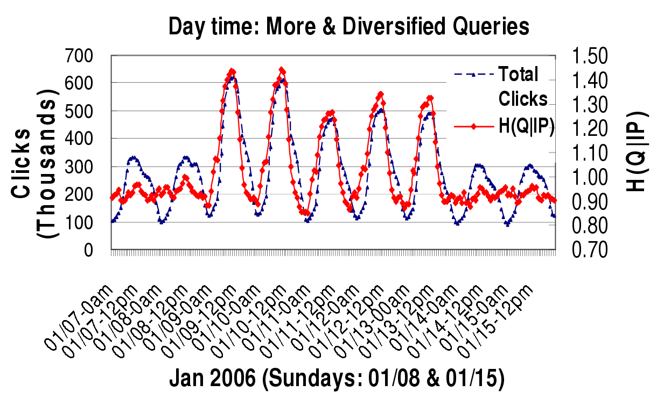
Day v. Night: More queries (and easier queries) during business hours
More clicks and diversified queries
Less clicks, more unified queries

Slide 66
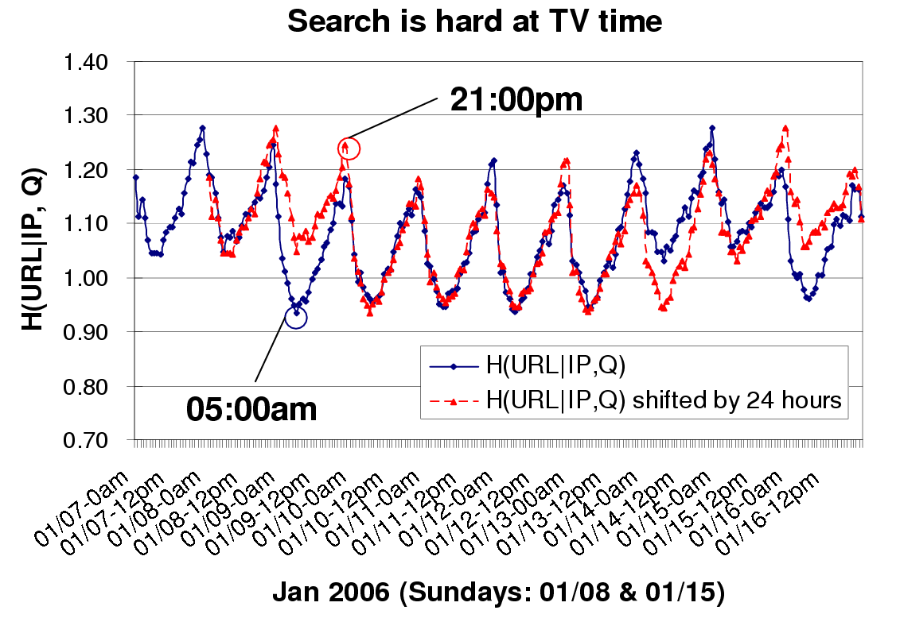
Harder Queries during Prime Time TV
Harder queries
Weekends are harder

Slide 67
Conclusions: Millions (not Billions)
How Big is the Web?
Upper bound: O(Population)
Not Billions
Not Infinite
Shannon >> Chomsky
How hard is search?
Query Suggestions?
Personalization?
Cluster in Cloud ($$$$) → Walk-in-the-Park ($)
Entropy is a great hammer

Slide 68
Conclusions: Personalization with Backoff
Personalization with Backoff
Cuts search space (entropy) in half
Backoff → Market Segmentation
Example: Business v. Consumer
Need: Segments ask different questions at different times
Value: Different advertising opportunities
Demographics:
Partition by ip, day, hour, business/consumer query…
Future Work:
Model combinations of surrogate variables
Group users with similarity → collaborative search

Slide 69
Noisy Channel Model for Web Search Michael Bendersky
Input → Noisy Channel → Output
Input’ ≈ ARGMAX_{Input} Pr( Input ) * Pr( Output | Input )
Speech
Words → Acoustics
Pr( Words ) * Pr( Acoustics | Words )
Machine Translation
English → French
Pr( English ) * Pr ( French | English )
Web Search
Web Pages → Queries
Pr( Web Page ) * Pr ( Query | Web Page )
Prior
Channel Model
Prior
Channel Model

Slide 70
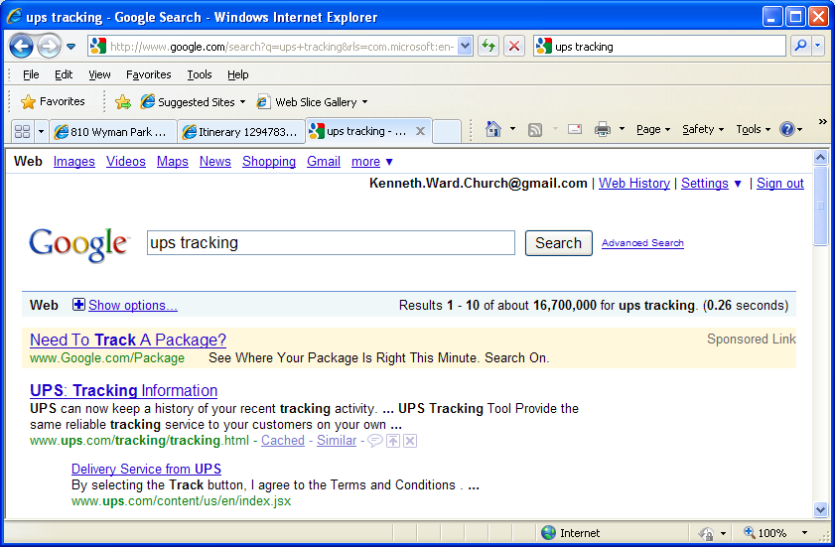
Document Priors
Page Rank (Brin & Page, 1998)
Incoming link votes
Browse Rank (Liu et al., 2008)
Clicks, toolbar hits
Textual Features (Kraaij et al., 2002)
Document length, URL length, anchor text
<a href="http://en.wikipedia.org/wiki/Main_Page">Wikipedia</a>

Slide 71
Query Priors: Degree of Difficulty
Some queries are easier than others
Human Ratings (HRS): Perfect judgments → easier
Static Rank (Page Rank): higher → easier
Textual Overlap: match → easier
“cnn” → www.cnn.com (match)
Popular: lots of clicks → easier (toolbar, slogs, glogs)
Diversity/Entropy: fewer plausible URLs → easier
Broder’s Taxonomy:
Navigational/Transactional/Informational
Navigational tend to be easier:
“cnn” → www.cnn.com (navigational)
“BBC News” (navigational) easier than “news” (informational)

Slide 72
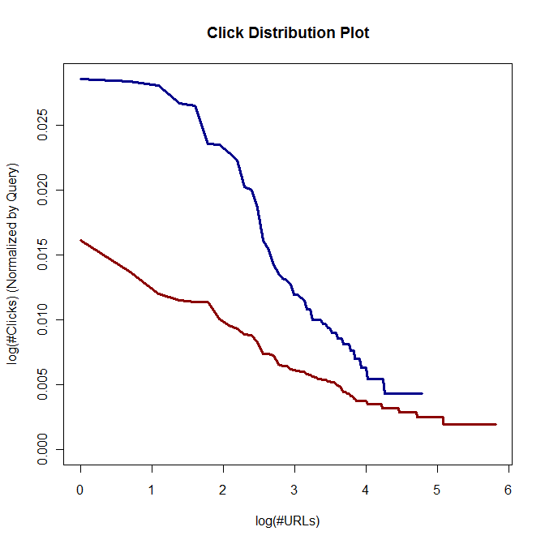
Informational vs. Navigational Queries
Fewer plausible URL’s → easier query
Click Entropy
Less is easier
Broder’s Taxonomy:
Navigational / Informational
Navigational is easier:
“BBC News” (navigational) easier than “news”
Less opportunity for personalization
(Teevan et al., 2008)
“bbc news”
“news”
Navigational queries have smaller entropy

Slide 73
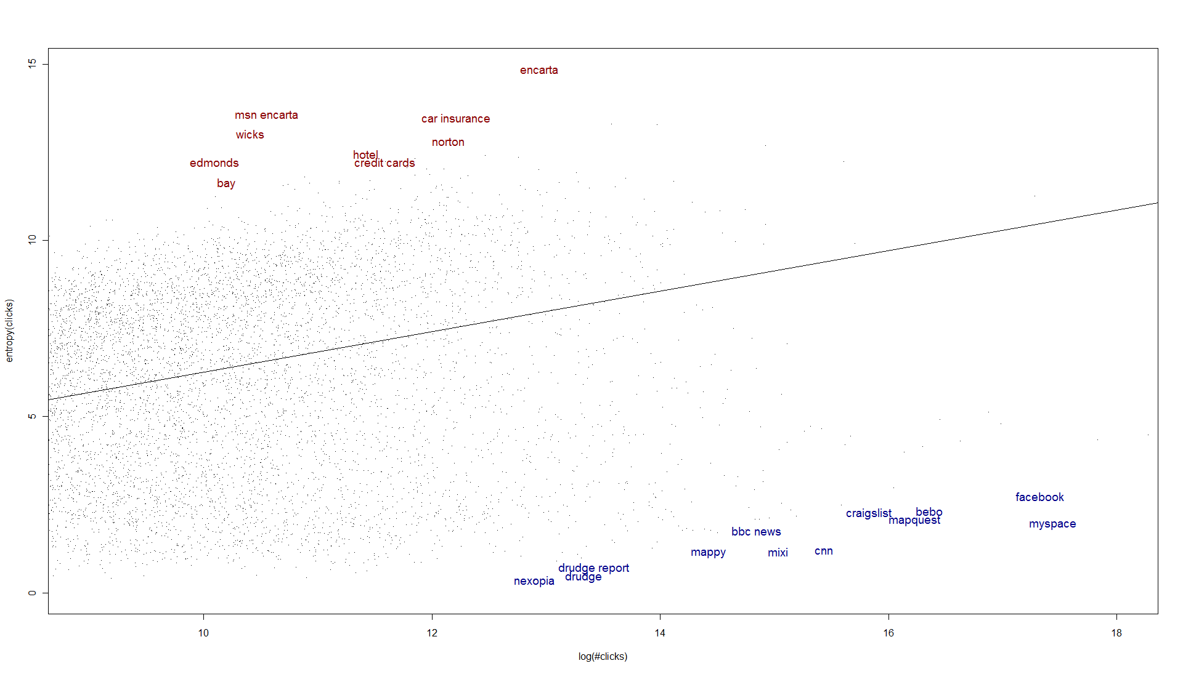
Informational/Navigational by Residuals
Informational
Navigational
ClickEntropy ~ Log(#Clicks)

Slide 74
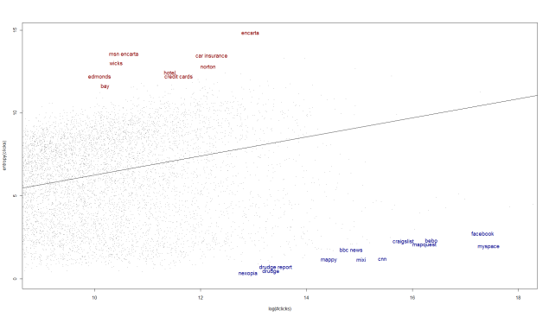
Informational Vs. Navigational Queries
Informational
Navigational
Residuals – Highest Quartile
Residuals – Lowest Quartile
"accuweather" "ako"
"bbc news" "bebo"
"cnn" "craigs list"
"craigslist" "drudge“
“drudge report" "espn"
"facebook" "fox news"
"foxnews" "friendster"
"imdb" "mappy"
"mapquest" "mixi“
“msnbc" "my"
"my space" "myspace"
"nexopia" "pages jaunes"
"runescape" "wells fargo"
"bay" "car insurance "
"carinsurance" "credit cards"
"date" "day spa"
“dell computers" "dell laptops“
"edmonds" "encarta"
"hotel" "hotels"
"house insurance" "ib"
"insurance" "kmart"
"loans" "msn encarta"
"musica" "norton"
"payday loans" "pet insurance "
"proactive" "sauna"

Slide 75
Alternative Taxonomy: Click Types
Classify queries by type
Problem: query logs have no “informational/navigational” labels
Instead, we can use logs to categorize queries
Commercial Intent → more ad clicks
Malleability → more query suggestion clicks
Popularity → more future clicks (anywhere)
Predict future clicks ( anywhere )
Past Clicks: February – May, 2008
Future Clicks: June, 2008

Slide 76
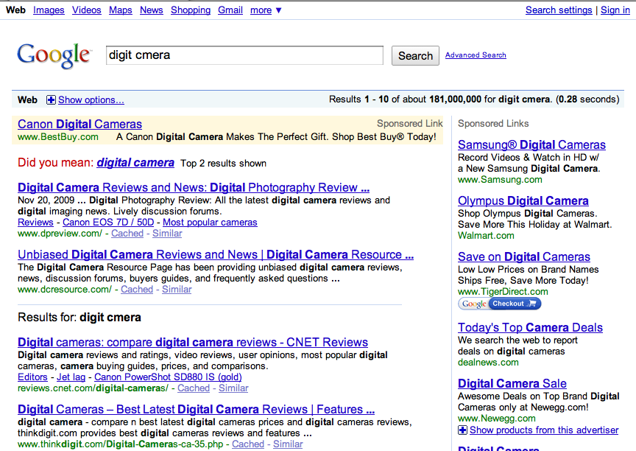
Left Rail
Query
Right Rail
Mainline Ad
Spelling Suggestions
Snippet

Slide 77
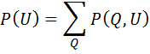
Aggregates over (Q,U) pairs
U
Q
Q
Q
Q
U
Improve estimation by adding features
MODEL | Q/U Features
Aggregates |  | Static Rank | Toolbar Counts | BM25F | Words In URL | Clicks
 | max
 | median
 | sum
 | count
 | entropy
Prior(U)
Improve estimation by adding aggregates

Slide 78
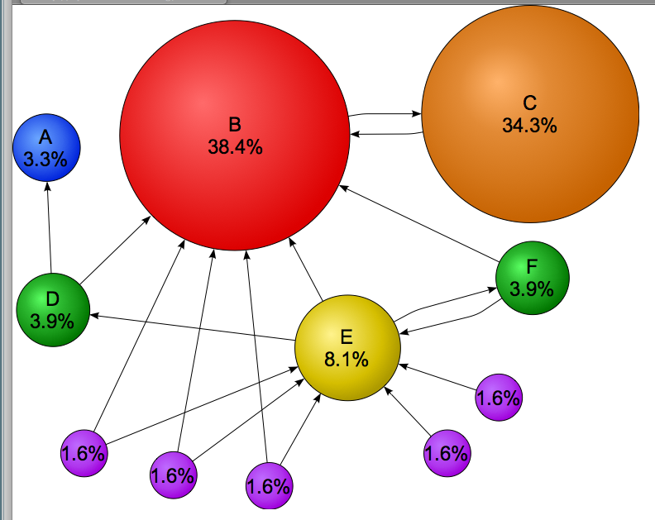
Page Rank (named after Larry Page) aka Static Rank & Random Surfer Model

Slide 79
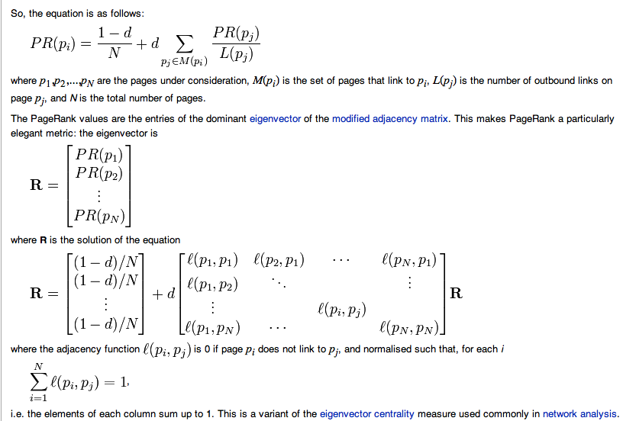
Page Rank = 1st Eigenvector http://en.wikipedia.org/wiki/PageRank

Slide 80
Document Priors are like Query Priors
Human Ratings (HRS): Perfect judgments → more likely
Static Rank (Page Rank): higher → more likely
Textual Overlap: match → more likely
“cnn” → www.cnn.com (match)
Popular:
lots of clicks → more likely (toolbar, slogs, glogs)
Diversity/Entropy:
fewer plausible queries → more likely
Broder’s Taxonomy
Applies to documents as well
“cnn” → www.cnn.com (navigational)

Slide 81
Task Definition
What will determine future clicks on the URL?
Past Clicks ?
High Static Rank ?
High Toolbar visitation counts ?
Precise Textual Match ?
All of the Above ?
~3k queries from the extracts
350k URL’s
Past Clicks: February – May, 2008
Future Clicks: June, 2008

Slide 82
Estimating URL Popularity
URL Popularity | Normalized RMSE Loss
 | Extract | Clicks | Extract + Clicks
Linear Regression
A: Regression | .619 | .329 | .324
B: Classification + Regression | - | .324 | .319
Neural Network (3 Nodes in the Hidden Layer)
C: Regression | .619 | .311 | .300
B is better than A
Extract + Clicks:
Better Together

Slide 83
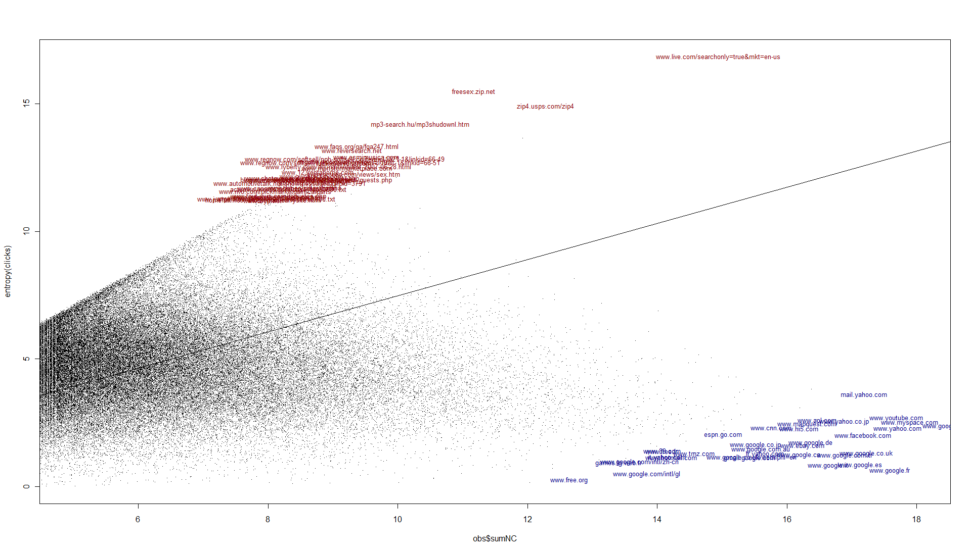
Destinations by Residuals
Fake
Destinations
Real
Destinations
ClickEntropy ~ Log(#Clicks)

Slide 84

Real and Fake Destinations
Fake
Real
Residuals – Highest Quartile
Residuals – Lowest Quartile
actualkeywords.com/base_top50000.txt
blog.nbc.com/heroes/2007/04/wine_and_guests.php
everyscreen.com/views/sex.htm
freesex.zip.net
fuck-everyone.com
home.att.net/~btuttleman/barrysite.html
jibbering.com/blog/p=57
migune.nipox.com/index-15.html
mp3-search.hu/mp3shudownl.htm
www.123rentahome.com
www.automotivetalk.net/showmessages.phpid=3791
www.canammachinerysales.com
www.cardpostage.com/zorn.htm
www.driverguide.com/drilist.htm
www.driverguide.com/drivers2.htm
www.esmimusica.com
espn.go.com
fr.yahoo.com
games.lg.web.tr
gmail.google.com
it.yahoo.com
mail.yahoo.com
www.89.com
www.aol.com
www.cnn.com
www.ebay.com
www.facebook.com
www.free.fr
www.free.org
www.google.ca
www.google.co.jp
www.google.co.uk

Slide 85
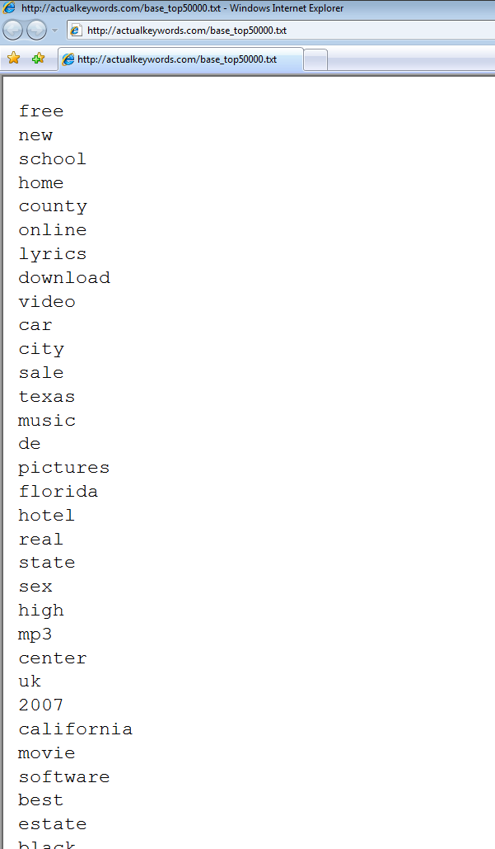
Fake Destination Example
Fake
actualkeywords.com/base_top50000.txt
Clicked ~110,000 times
In response to ~16,000 unique queries
Dictionary Attack

Slide 86
Learning to Rank with Document Priors
Baseline: Feature Set A
Textual Features ( 5 features )
Baseline: Feature Set B
Textual Features + Static Rank ( 7 features )
Baseline: Feature Set C
All features, with click-based features filtered ( 382 features )
Treatment: Baseline + 5 Click Aggregate Features
Max, Median, Entropy, Sum, Count

Slide 87
Summary: Information Retrieval (IR)
Boolean Combinations of Keywords
Popular with Intermediaries (Librarians)
Rank Retrieval
Sort a collection of documents
(e.g., scientific papers, abstracts, paragraphs)
by how much they ‘‘match’’ a query
The query can be a (short) sequence of keywords
or arbitrary text (e.g., one of the documents)
Logs of User Behavior (Clicks, Toolbar)
Solitaire → Multi-Player Game:
Authors, Users, Advertisers, Spammers
More Users than Authors → More Information in Logs than Docs
Learning to Rank:
Use Machine Learning to combine doc features & log features

